Slide 1
SENTIMENT ANALYSIS On Hotel Reviews
Presented by:
Akula Nikhil

Slide 2
INTRODUCTION
Objective: To build a sentiment analysis model that classifies hotel reviews as positive, negative, or neutral.
Purpose: To analyze customer feedback and identify key topics or areas of concern to improve service quality.
Scope: Focus on text data preprocessing, model building, and insights generation.

Slide 3
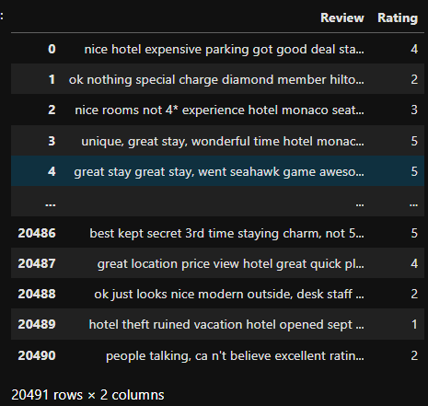
DATA COLLECTION
Collect the data from kaggle which contains 2 columns and 20491 rows
Column names are Review and Rating.
Dataset link:- https://www.kaggle.com/datasets/andrewmvd/trip-advisor-hotel-reviews

Slide 4
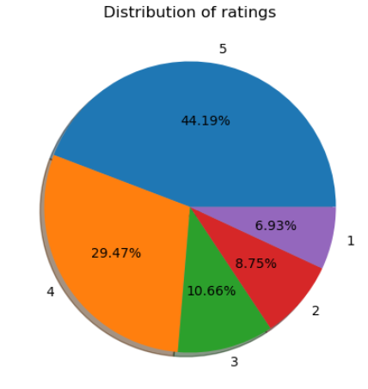
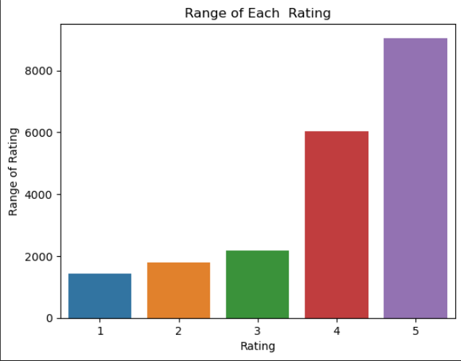
EXPLORATORY DATA ANALYSIS
Ratings Distribution:
Bar plot showing the Range of review ratings
Pie plot showing the percentage of each review ratings
Insights:-
Most of the people rated 5 (in counts 9054 and percentile 44.19)
Least of were rated 1 (in counts 1421 and percentile 6.93)

Slide 5
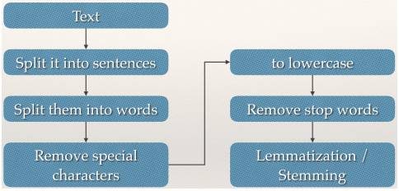
DATA PREPROCESSING
Text Cleaning: Remove stop words, punctuation, and special characters.
Normalization: Convert text to lowercase and tokenize.
Lemmatization: Reduce words to their base form.
Vectorization: Transform text into numerical features using techniques like TF-IDF or word embeddings.

Slide 6
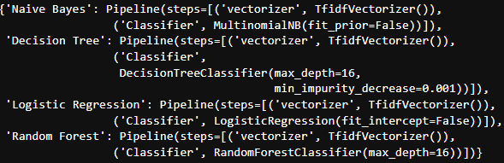
MODEL BUILDING
Algorithm Selection: Use algorithms such as Logistic Regression, Naive Bayes,Decision Tree and Random Forest.
Training: Split data into training and testing sets.
Evaluation: Measure performance using metrics accuracy.
Fine-Tuning: Optimize hyperparameters and GridSearchCv for best performance .

Slide 7
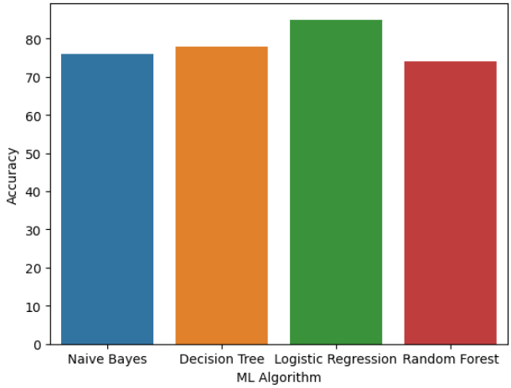
RESULTS
Among all Models Logistic Regression gives Best accuracy.
Among all models Decision Tree Takes less space to store the model.

Slide 8
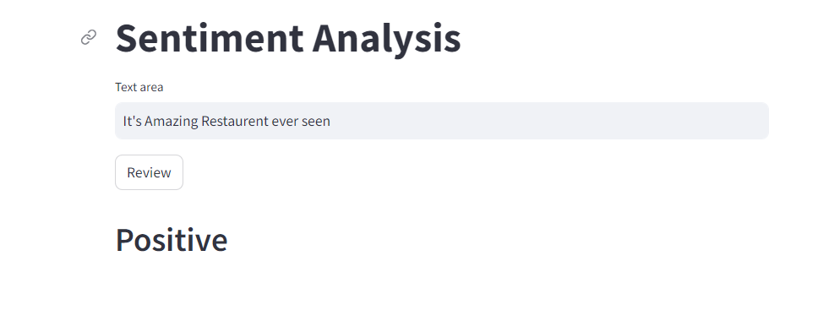
DEPLOYEMENT
Save the Each model Using Joblib(.pkl) file
Create a streamlit application to show the review once the user enter a review.

Slide 9
Thank You !

